Slide 1
Separable Approximation of
Ambient Occlusion
Jing Huang¹ Tamy Boubekeur¹ Tobias Ritschel^{1,2}
Matthias Holländer¹ Elmar Eisemann¹
¹Télécom ParisTech - CNRS/LTCI
²Intel Visual Computing Institute

Slide 2
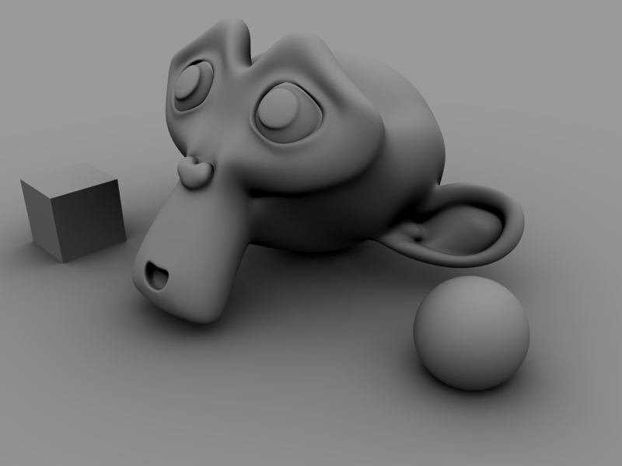
Ambient Occlusion
Fast approximation of a subset of indirect lighting effects
Notes:
Ambient Occlusion, or AO, is a popular effect which captures a subset of indirect lighting effect. Here is an example with the AO component only on which already gives a fair perception of the scene’s components.

Slide 3
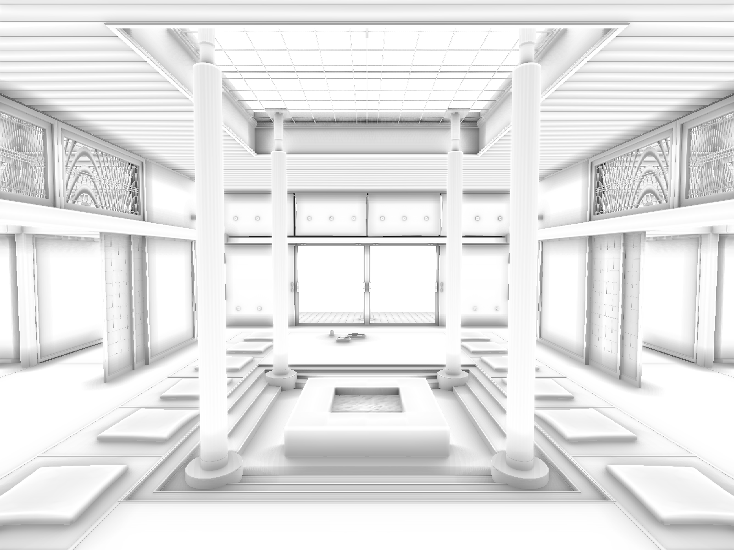
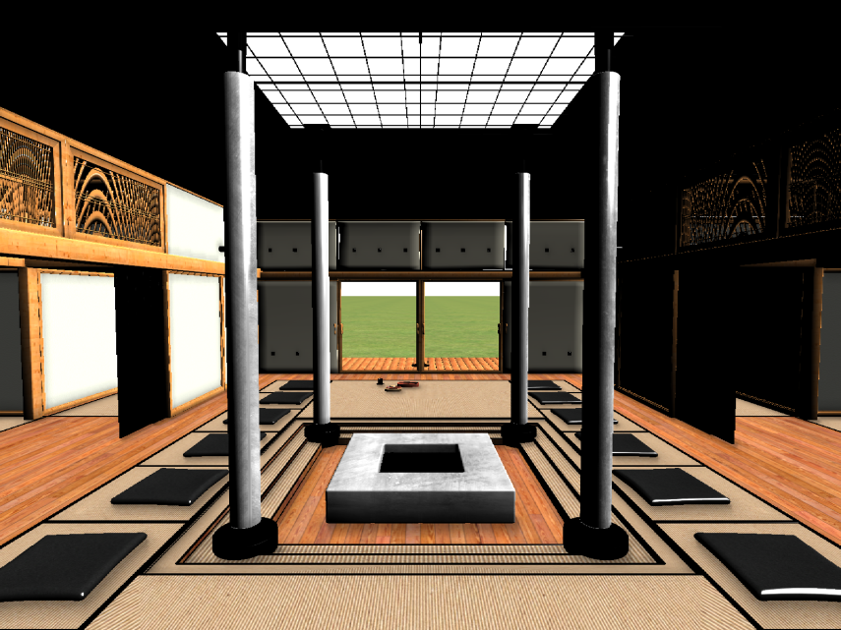
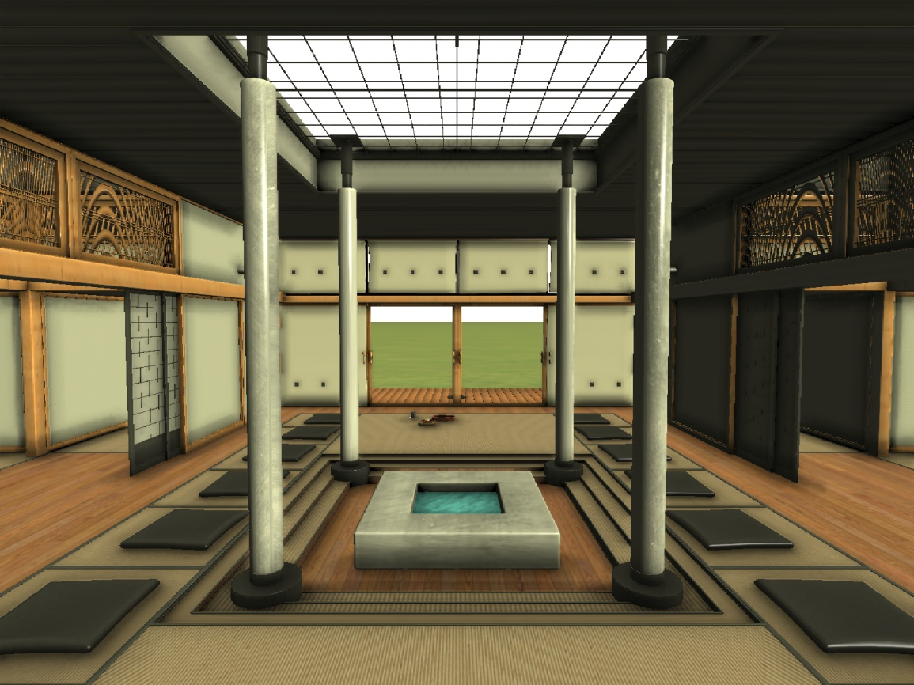
Ambient Occlusion
Notes:
Here is another example of AO in an interior scene
On the left we show the AO component only; on the right, the direct lighting in OpenGL only.
Combining both offers a more realistic result than direct lighting only, while being less expensive than complete global illumination for instance.

Slide 4
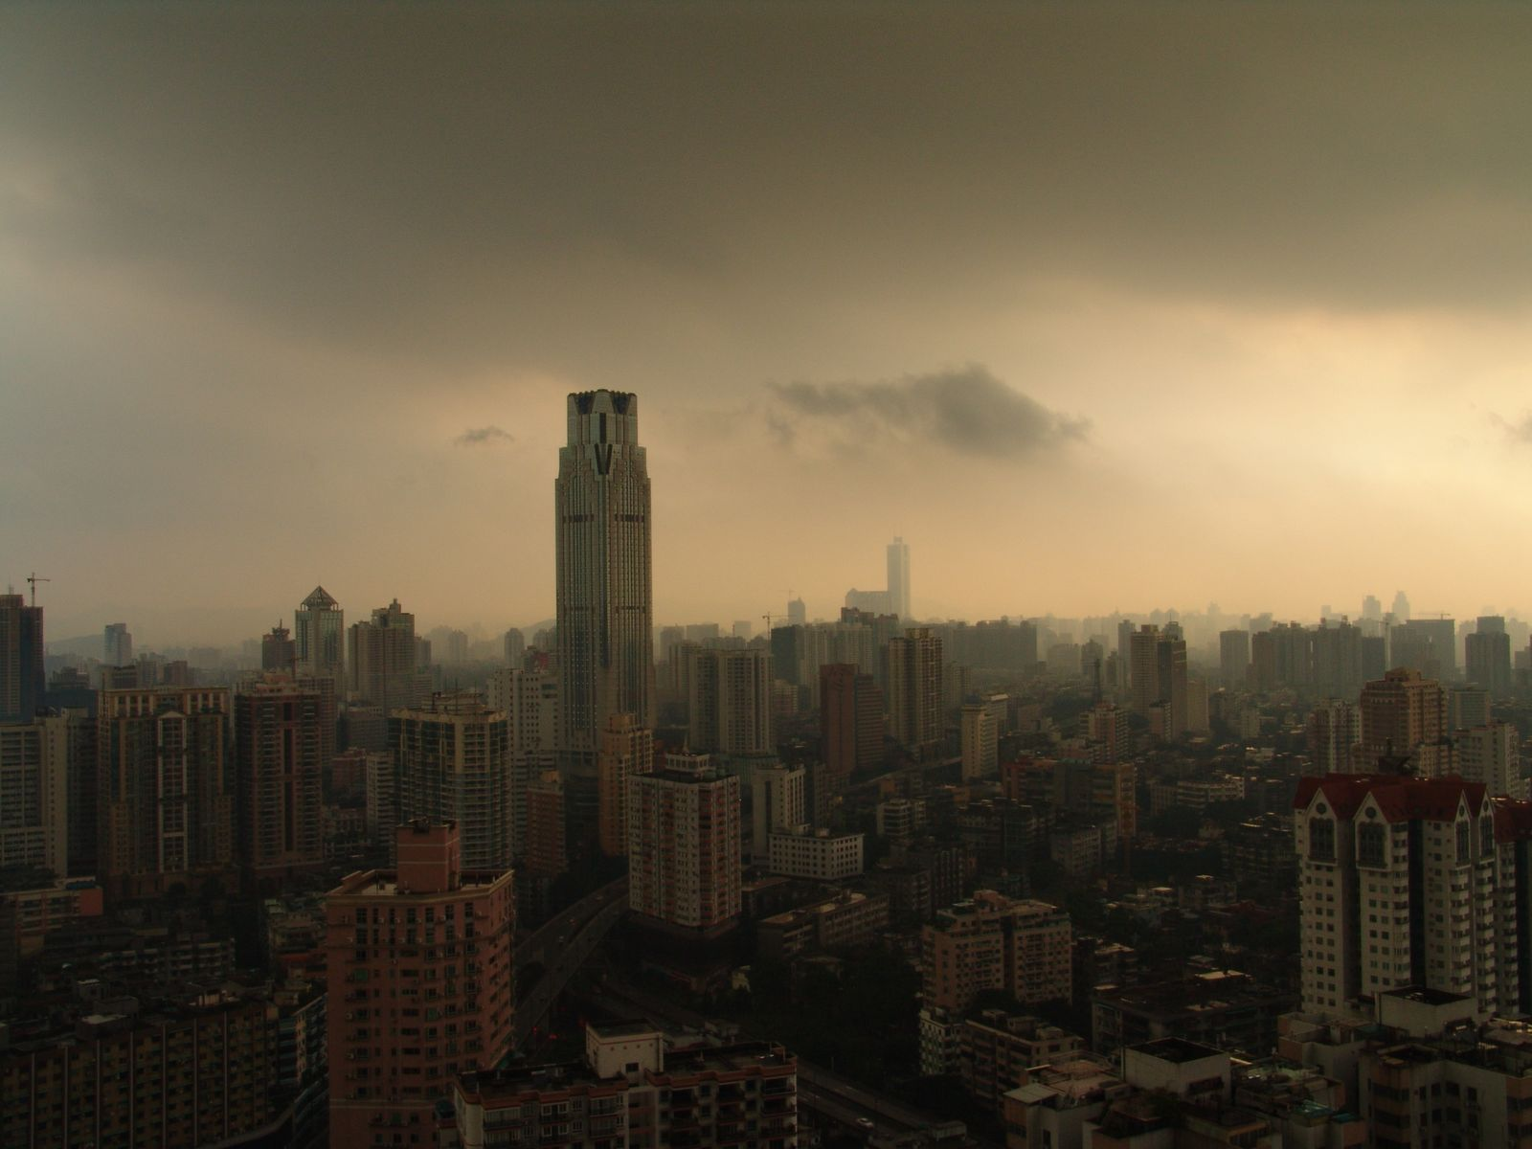
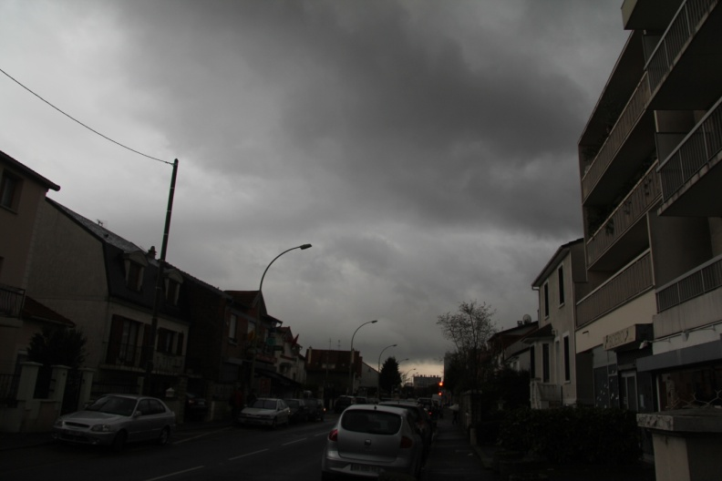
Ambient Occlusion
AO = shadow created by ambient illumination
Ref photo : Guangzhou - Cloudy Day
Was first introduced by M. S. Langer & S. W. Zucker («Shape from shading on a cloudy day», 1994)
Capturing surface variation using accessibilty shading by Gavin Miller («Efficient Algorithms for Local and Global Accessibility Shading», 1994)
Notes:
What is really AO ?
It describes the shadow which is not created by direct lighting, but by a « virtual » diffused surrounding light emitter.
This notion was introduced by two papers.
One is « Shape from shading on a cloudy day», they extended the classical shape from shading model, which reconstruct the shape not only from lambertian model, but also from area diffused lighting which is produced in a cloudy day.
Later on, accessibility, which can be seen as a form of ambient occlusion, was established using maximum non—intersecting spheres near geometry to model the amount of light that can reach a point from « outside the shape ».

Slide 5
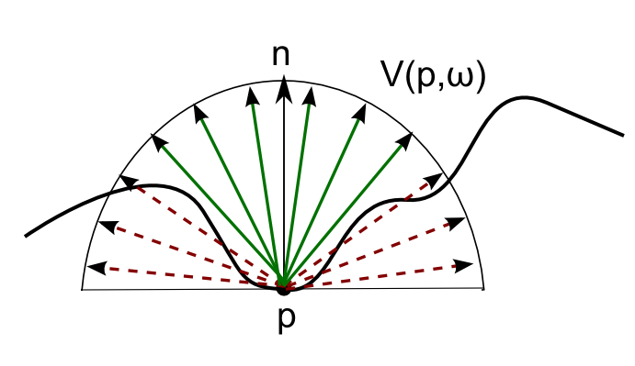
Ambient Occlusion
Integral of Visibility all over the hemisphere
Notes:
More formally, ambient occlusion is usually defined as the integral of the visibility function – often restricted to a user-defined distance – over the hemisphere.
Intuitively, it measures how much light might potentially be « blocked » by nearby geometry.
Note that ambient occlusion is actually independent of the light sources explicitly defined in the scene.

Slide 6
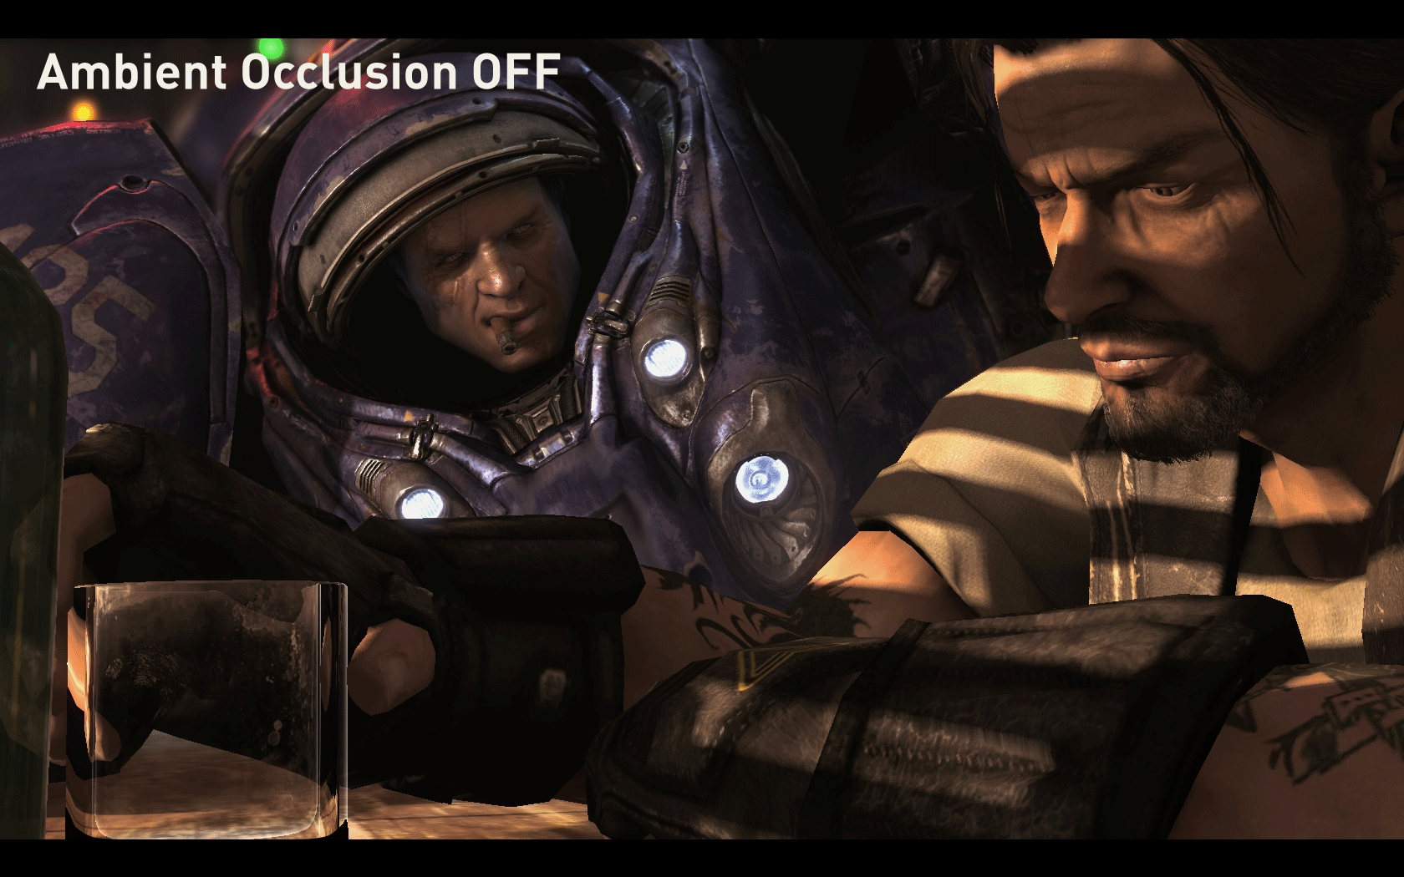
Ambient Occlusion
Improving the perception of volume, concavities & contact areas of 3D objects
AO in
Starcraft II.
Notes:
One of the main effect of ambiant occlusion, besides the « cuteness » it provides, is that volumes, concavities and contact
areas are far better perceived using it than with direct lighting only.
Offline AO rendered by ray tracing >> prohibitive for real time applications

Slide 7
Evaluation
Estimated by ray tracing
Prohibitive for real time rendering
Notes:
In offline rendering, AO is evaluated using Monte Carlo integration by ray tracing.
Unfortunately, this is often too costly for real time applications.

Slide 8
Screen-Space Ambient Occlusion
For Real Time Applications

Slide 9
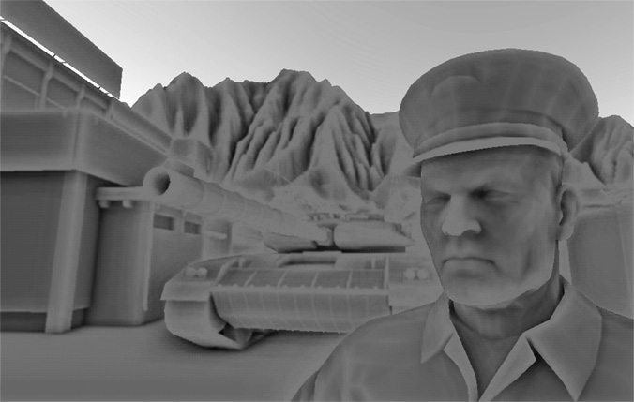
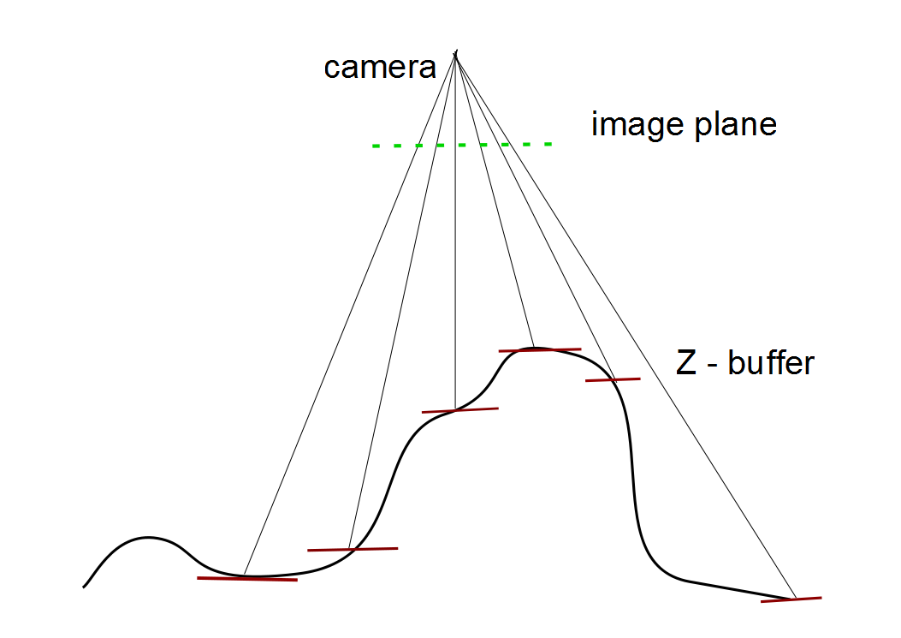
Screen Space Ambient Occlusion
SSAO
Main idea:
using the depth-buffer as a cheap, randomly accessible substitution for the actual scene’s geometry.
Casting AO computation as a local filter in screen space
CryEngine [Mittring 2007]
Notes:
Screen-Space estimators have been introduced to cope with real time constraints.
The basic idea is to use the Z-Buffer as a substitute to the actual geometry of the scene to sample occlusion locally.
The fastest and simplest method for such a process has been introduced by Mittring in the Crysis1 by CryTek.
Conceptually, this is a local fitler in screen space which samples 3D points in the vicinity of a pixel and approximate the ammbient occlusion at the pixel with the amount of points which fails under the z-buffer.

Slide 10
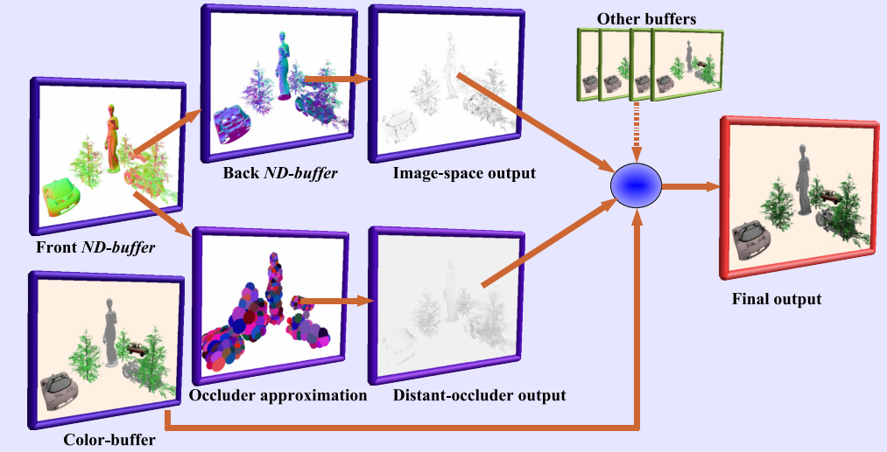
Screen Space Ambient Occlusion
[Shanmugam and Okan 2007], [McGuire 2010]
Notes:
Another SSAO method has been itroduced by Shanmugam. It decomposes AO into two components:
- a local component, responsible for high frequency AO content, and evaluated in screen space using the depth buffer
- a distant component, capturing low frequency only, and evaluated using geometry proxies made of bounding spheres and each projected onto its own billboard, and rasterized whole of them.
Mr Mcguire’ Ambient Occlusion Volumes use a similar idea, he computes the ao value by replacing billboard with full 3d bounding volume which was created in the first shading pass.

Slide 11
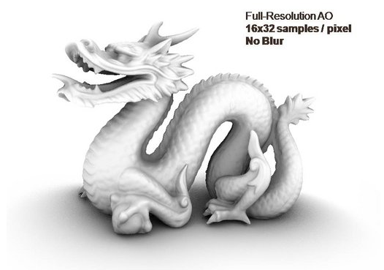
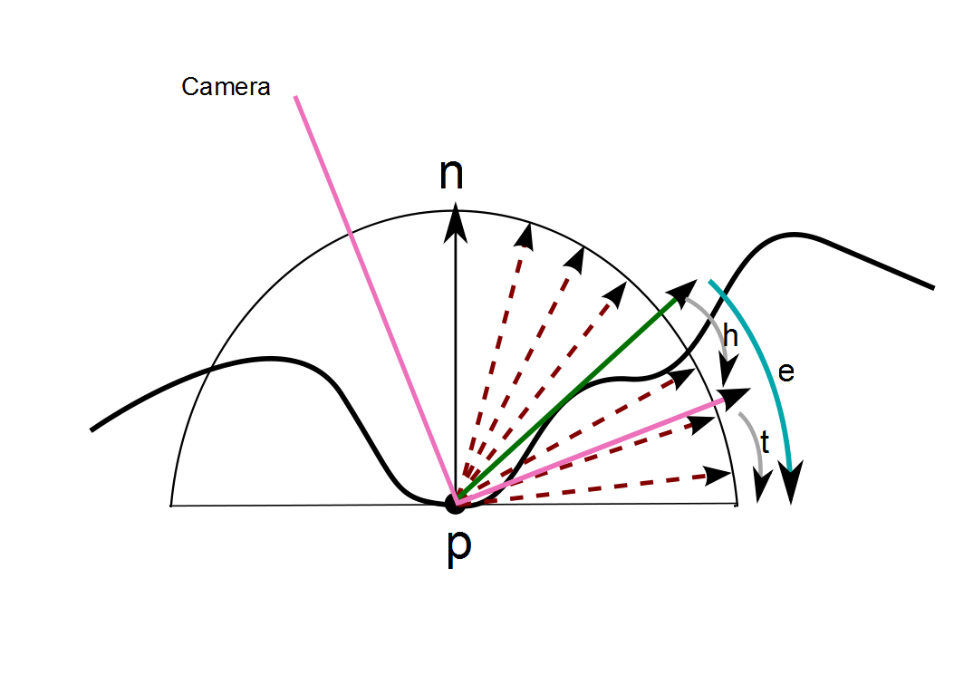
Screen Space Methods
Horizon-Based AO [BAVOIL 2008] depends on the elevation angle e
Notes:
The third method we mention here is HBAO which runs entirely in Screen Space Method and has very good results compare to other SSAO method.
AO : depends on ElevationAngle (e)
e = h + t
h : horizon angle
t : tangent angle
They take random samples directions and step along the directions to get the best Elevation Angle for each direction.
The AO is computed by filtering ElevationAngles.
Although of higher quality, this method has a larger computational footprint than Crytek SSAO for instance.

Slide 12
Hybrid Ambient Occlusion
Accounts for «outside the view» occluders [Reinbothe 2009]
Notes:
Finally, hybrid methods such the volumetric approach by Reinbothe,
can also perform computation in screen space but starts by performing a 3D rasterization of the scene at each frame to account for potential occluders located outside the field of the view,
and therefore not captured by classical, depth-buffer based, SSAO methods.

Slide 13
Problem
Can we go a step further ?
SSAO already reformulated a 3D raytracing process into a 2D screen space layout
Can we work in 1D ?
Observation:
SSAO looks like a local image filter.
Idea:
Propose a separable (2x1D) AO approximation instead of a full (2D) evaluation
Notes:
Usual pb is the cost , and 1d sampling could be less expensive than 2d & 3d sampling
Reduce the complexity can also improve original method.
We also noticed with one stochastic sample per pixel, we can get coarse result. But not good enough.
And as some paper mentioned like Phams paper separable bilateral filter for the video compression process, using separable idea can have a good acceleration for whole application.

Slide 14
Separable Approximation of Ambient Occlusion

Slide 15
Separable Gaussian Filter
Notes:
Our work is inspired by the gaussian kernel which can be evaluated in a separable fashion on pictures for instance. This means that 2D computation can safely replaced by 2 1D computations, reducing the complexity from n squared to n.

Slide 16
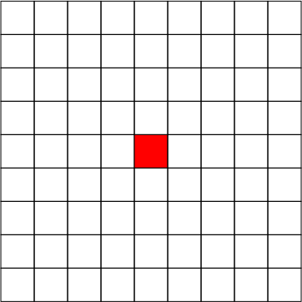
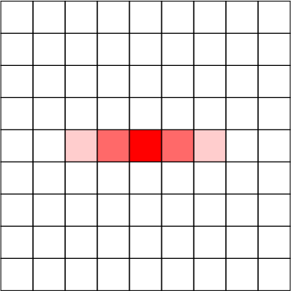
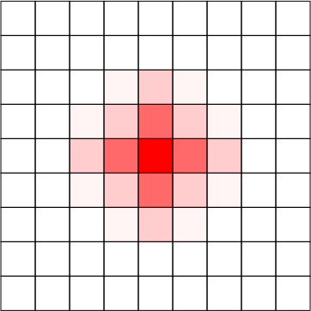
Separable Gaussian Filter
Notes:
Here is an illustration of the process.

Slide 17
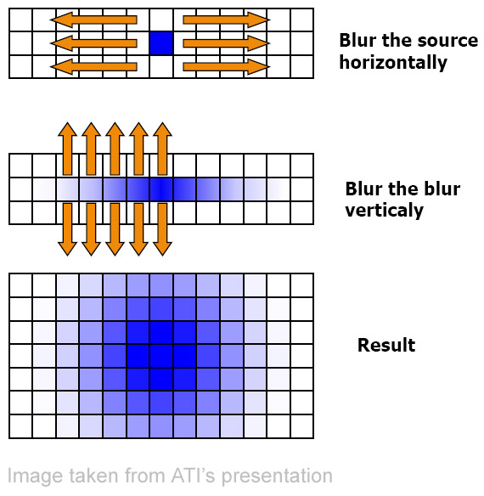
Separable Gaussian Filter

Slide 18
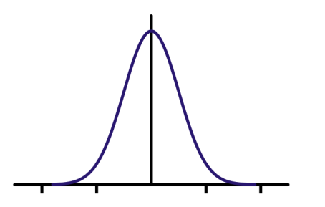
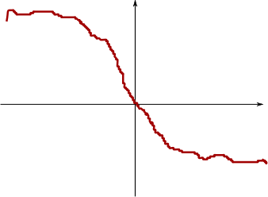
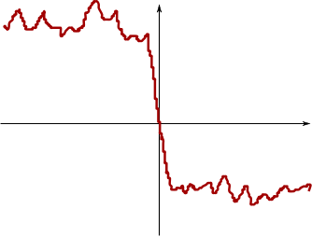
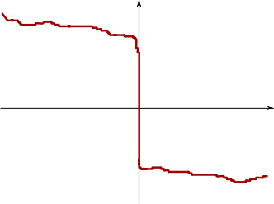
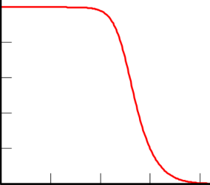
Bilateral Filter
With gaussian filter
With bilateral filter
Original signal
Notes:
Now the bilateral filter allows to better preserve features by combining 2 kernels.

Slide 19
Separable Bilateral Filter
Mathematically not separable
But convincing separable approximation [Pham 2005]
Notes:
As mentioned in Pham’s paper, using separable bf can speed up the processing, but the same time creats edge jaggedness, they solved this problem later [Pham 2007] by aligning the seperation axis to the image gradients.

Slide 20
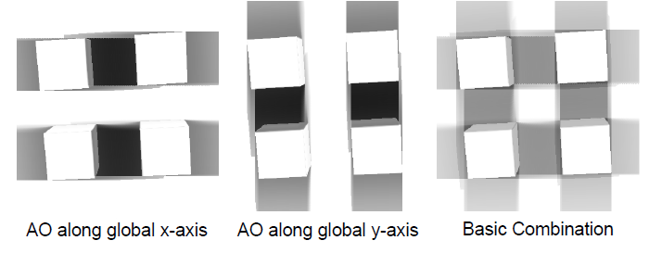
Separable AO
Separate AO sampling along 2 orthogonal axes in a 2-pass process
Evaluation along each axis using any kind of SSAO
Occlusion estimation (Crytek, HBAO, etc)
Sampling (uniform, random, jittered, etc)
Need spatially varying directions for removing directional banding artifacts
Solution: Local Frame Randomization
Notes:
Therfore, we propose to speed up SSAO by defining a separable approximation principle.
As mentioned for the seperable Gaussion filter, the complexity can be reduced from n² to n.
In our case. Although AO is not formally separable, we show that a separable approximation gives convincing results, with almost no visual artifact comparted to full evaluation.
The basic idea is to perform 2 AO evaluations at each point, along 2 orthogonal directions.
Any SSAO occlusion estimator can be used, combined with any occlusion point sampling, as long as it can be restricted to a single direction in screen space.
As illustrated here, the direct combination of both evaluations gives a low quality, rough approximation of AO due to the arbitrary choice of the computation axis.
We solve this problem by choosing different separation directions for each pixel using a local frame randomization.

Slide 21
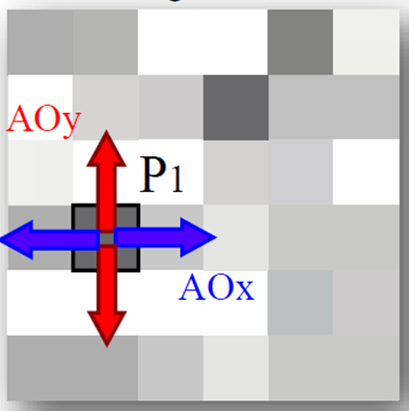
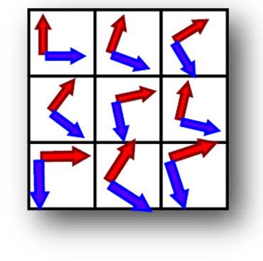
Local Frame Randomization
Randomize the orientation of the local frame (axis pair) at each pixel
Avoids banding artifacts.
Notes:
That is what we did for local randomization. Shows 3 steps.
3 images : for each pixel, we do AO evaluation along orthogonal axes -> with Axis pattern, we define local per-pixel frames

Slide 22
Distribution Pattern [Pharr 2004]
Using different distribution pattern:
Random
Stratified sampling
Regular
Jittered
Low-discrepancy sampling
Halton sequence
Hammersley sequence
Random
Regular
Jittered
Halton
Hammersley
Notes:
The distribution patterns is a key component for ensuring the quality of final AO buffer. We use the Hammersley sequence which seems to be the best choice in practice.

Slide 23
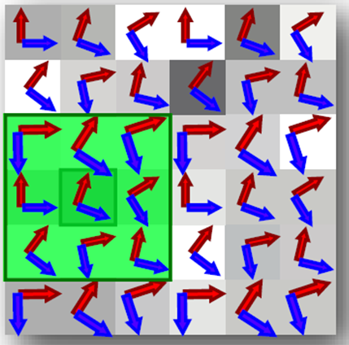
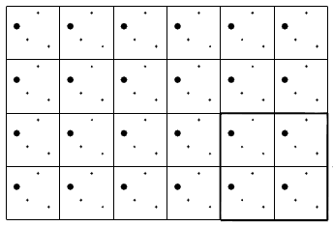
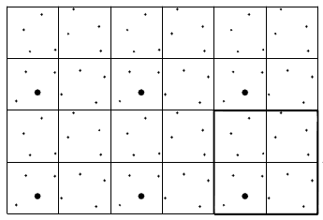
Interleaved Sampling [Keller 2001]
Regularly replicated basis pattern
Between regular & irregular sampling
Regular Pattern
Interleaved Pattern
Notes:
Integration with Hammersley ? Better Justification ?
in the end, we use Feature-preserving filter kernel which correlates with axis pattern to do edge aware boxfilter.
And we found the edge aware boxfilter with interleaved sampling can have good combinations, easily to control.
With the interleaved sampling, we need just to use the same size for the filter(edge aware). The noise can be easily removed.

Slide 24
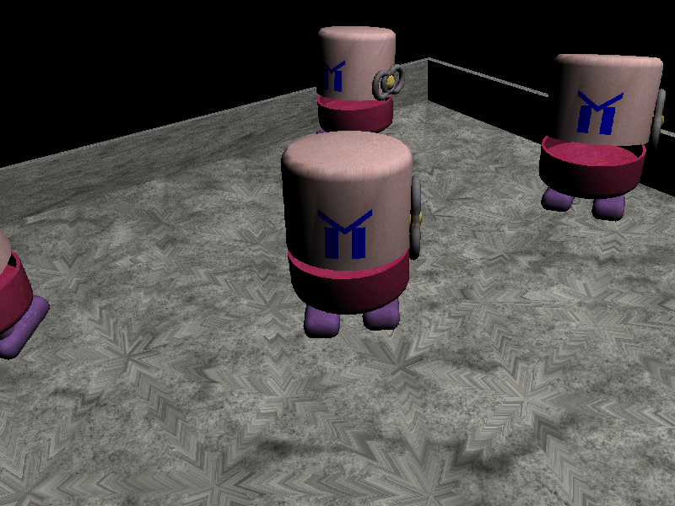
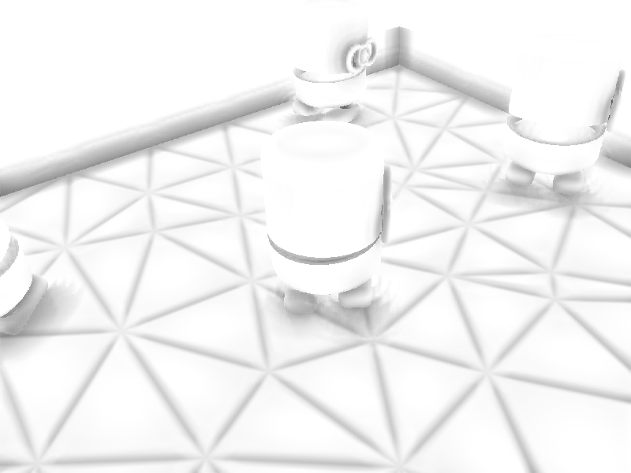
Interleaved Sampling [Keller 2001]
«Toasters»
Notes:
One example shows the scene «Toasters», we need look at one part of the scene, « the toaster’s feet»

Slide 25
Interleaved Sampling [Keller 2001]
Sampling
4 x 4 Boxfilter Results
High Frequency Random
AO in
« Toaster’s feet »
4 x 4 Interleaved
Advantage :
easy to filter
save memory
Notes:
The image shows the advantage of interleaved sampling for SSAO, using the same size boxfilter kernel can easily remove the pattern noise which was created by interleaved sampling.
With the totally random sampling, it²s difficult to control.
Also in the same time, you can save the memory, instead of using a big length random vector for all pixels, you need save the samples only for one pattern.

Slide 26
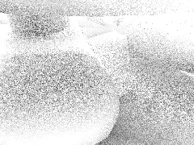
Interleaved Sampling [Keller 2001]
Sampling
4 x 4 Boxfilter Results
4 x 4 Interleaved
AO in
« Toast’s feet »
High Frequency Random
Advantage :
easy to filter
save the memory
Notes:
The image shows the advantage of interleaved sampling for SSAO, using the same size boxfilter kernel can easily remove the pattern noise which was created by interleaved sampling. With the totally random sampling, it²s difficult to control.
Also in the same time, you can save the memory, instead of using a big length random vector for all pixels, you need save the samples only for one pattern.

Slide 27
Results

Slide 28
Performance
Size | Separable | Crytek | Vol. Obs | HBAO
 |  | [Mit07] | [LS10] | [BSD08]
5 | no | 3.2ms | 3.5ms | 3.6ms
 | yes | 3.4ms | 3.6ms | 3.5ms
11 | no | 13.9ms | 14.8ms | 15.0ms
 | yes | 5.8ms | 5.9ms | 6.0ms
21 | no | 49.7ms | 51.9ms | 51.9ms
 | yes | 9.9ms | 9.9ms | 10.2ms
Resolution 1024 x 768
GPU Nvidia GTX 480
Notes:
As show in this table, with same kernel, separable AO will have good improvement in speed FOR a SIMILAR VISUAL QUALITY.

Slide 29
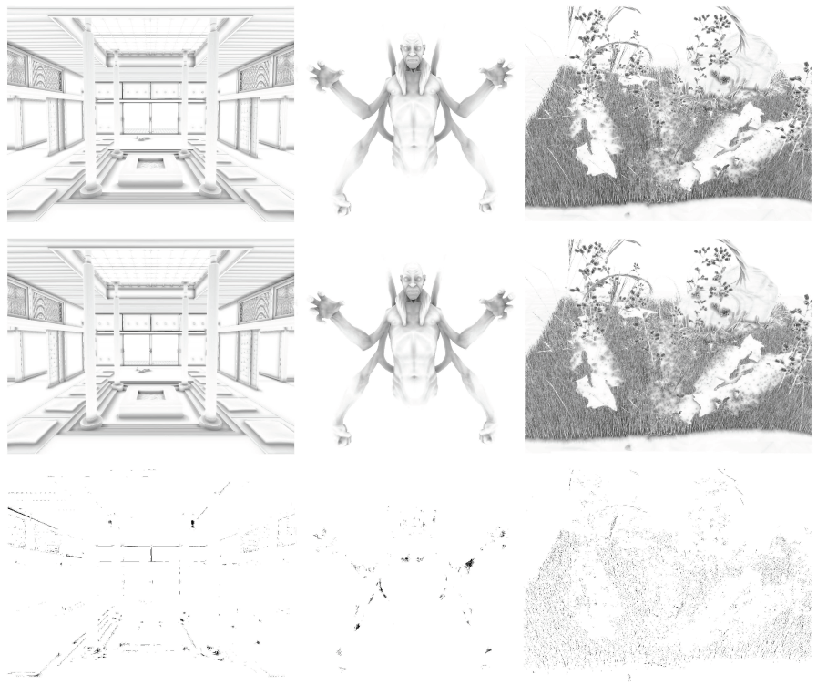
Perceptual Error
Reference
HBAO
Separable
Perceptual Difference in Lab space. [Yee 2004]
Measured against the exact computation for each technique using [Mittring 2007] [BAVOIL 2008]
Notes:
We measured the error introduced by our method using a perceptual error metric. Has shown on these tree examples, the error is low, even on direct AO visualization. Note the it gets even lowers when doing full shading.

Slide 30
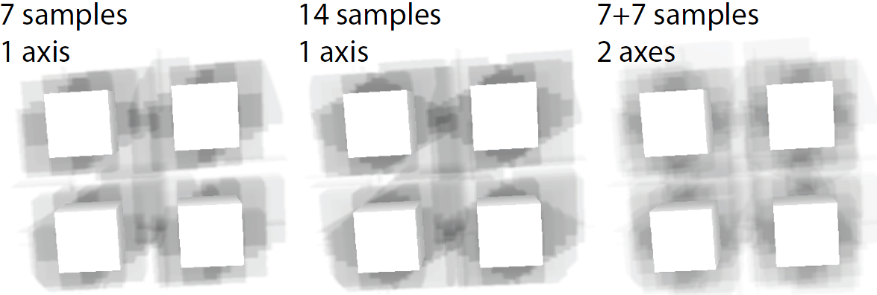
Local Frame Randomization
Notes:
As shown here, the choice of 2 random axis is superior to one, even using the same number of occlusion evaluation per-pixel

Slide 31
Video
Notes:
Here are some results we obtained with our approach.

Slide 32
Limitations
Inherited from the particular SSAO technique using to evaluate along the 2 axis
Missed occluders (outside the frustum)
Could be solved by voxelization [Reinbothe 2009]
Over occlusion
Could be solved by depth peeling [Ritschel 2009]

Slide 33
Conclusion
Separable Approximation of Ambient Occlusion
Faster than complete evaluation
Compatible with all SSAO methods
No visible error
Same principle can be applied to other screen-space rendering techniques

Slide 34
Acknowledgements
ANR Projects « Cecil » and « MEDIAGPU »
European Network of Excellence « 3DLife »
Help from Telecom ParisTech: Catherine Pelachaud, Bert Buchholz, Jean-Marc Thiery

Slide 35
Thank you for your attention
Thanks
Merci
谢谢
Danke
Obrigado
Gracias

Slide 36
Reference
[BL99] BÜLTHOFF H. H., LANGER M. S.: Perception of shape from shading on a cloudy day, 1999.
[BSD08] BAVOIL L., SAINZ M., DIMITROV R.: Image-space horizon-based ambient occlusion. In ACM SIGGRAPH 2008 Talks (2008), pp. 22:1–22:1.
[Bun05] BUNNELL M.: Dynamic ambient occlusion and indirect lighting. GPU Gems 2 (2005), 223–233.
[KH01] KELLER A., HEIDRICH W.: Interleaved sampling. In Proc. EGWR ’01 (2001), pp. 269–276.
[McG10] MCGUIRE M.: Ambient occlusion volumes. In Proc. ACM HPG ’10 (June 2010).
[Mit07] MITTRING M.: Finding next gen: CryEngine 2. In ACM SIGGRAPH ’07 Courses (2007), pp. 97–121.
[PV05] PHAM T. Q., VLIET L. J.: Separable bilateral ﬁltering for fast video preprocessing. In Proc. IEEE Int. Conf. on Multimedia and Expo (2005), pp. 1–4.
[RBA09] REINBOTHE C., BOUBEKEUR T., ALEXA M.: Hybrid ambient occlusion. EUROGRAPHICS ’09 Areas Papers (2009).
[RGS09] RITSCHEL T., GROSCH T., SEIDEL H.-P.: Approximating dynamic global illumination in image space. In Proc. ACM I3D ’09 (2009), pp. 75–82.
[SA07] SHANMUGAM P., ARIKAN O.: Hardware accelerated ambient occlusion techniques on GPUs. In Proc. ACM I3D ’07 (2007), pp. 73–80.

